Slide 1
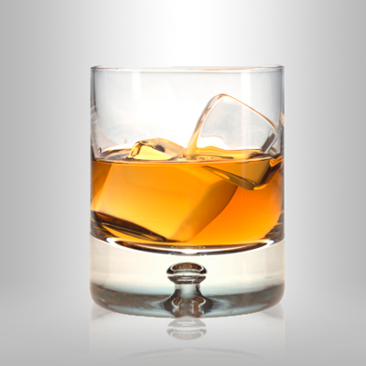
Whiskey Business
Or: How I Learned to Stop Worrying and Follow the Money

Slide 2
Marketing QUestions
Which types of liquor sell best?
Are there types of liquor with lower sales and higher revenue?
Should our marketing campaign be focused in smaller markets or larger ones?
Is there a time of year when it is best to market our product?
Which brands/vendors should we partner with?

Slide 3
Summary of tables
Counties- 99 counties, 21% live in Top 2: Polk (Des Moines) and Linn (Cedar Rapids), 50% are in Top 10
Stores- 1973 stores, 1425 are active (72.2%)
Sales- 3,049,913 individual sales
Products- 9977 products (initially listed in 70 categories)

Slide 4
CONDENSED liquor TYPES
11 liquor categories: Beer, Brandy, Cocktail, Gin, Liqueur, Rum, Schnapps, Tequila, Vodka, Whiskey, Other

Slide 5
SHARES BY LIQUOR TYPE

Slide 6
Let’s sell more whiskey!

Slide 7
Small vs. big county?

Slide 8
SMALL VS. BIG COUNTY?

Slide 9
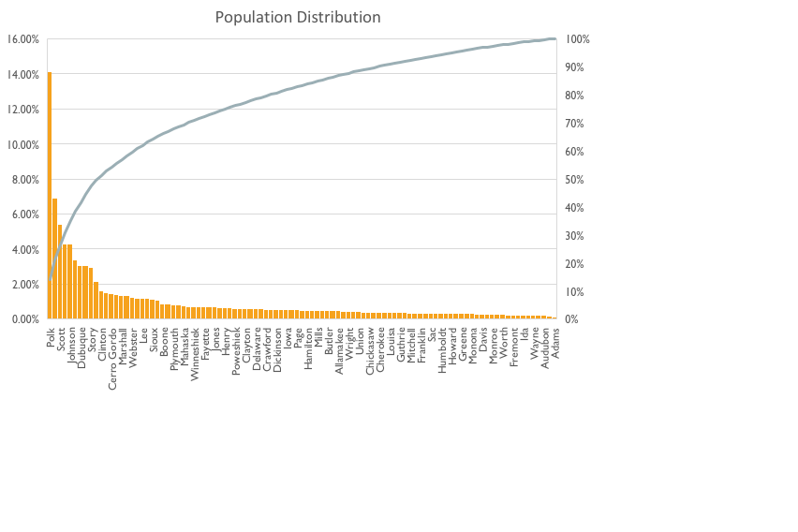
POPULATION AND REVENUE DISTRIBUTIONS

Slide 10
LIQUOR REVENUE IN TOP 5 COUNTIES

Slide 11
WINTER VS. SUMMER SALES
Notes:
January-March vs. June-August

Slide 12
WINTER VS. SUMMER REVENUE
Notes:
January-March vs. June-August

Slide 13
tOP VENDORS BY REVENUE

Slide 14
LIMITATIONS/assumptions
Missing values
Alcohol categories sorted into “Other”
Assumption: These weren’t significant enough to affect our results or my recommendation (this assumption is fact!)

Slide 15
RECOMMENDATION
It’s quite simple– we market the most popular product (whiskey) in the biggest markets (Polk, Linn, Scott, Black Hawk, and Johnson counties)
Focus our campaigns in the winter months, when there’s a higher demand for whiskey (and alcohol in general)
Reach out to our top 5 vendors (particularly Jim Beam and Diageo) and set up some marketing campaigns
Follow the money! We won’t need to look far because…

Slide 16
…The money is already there!

